Slide 1


NATD SEaaS Service Catalog
August 2017

Slide 2









NATD Solution Engineering Service Catalog
Cloud Execution Framework Services
Awareness
Demand
Opportunity
Success
Deliver a Cloud Day
Develop a Cloud Vision
Design a Cloud Solution
Adopt a Cloud Solution
Support a Marketing Event
Develop a Value Hypothesis
Build a POC
Support Onboarding
Build an Executive Briefing
Create a Packaged Proposal
Build a Business Case
Deliver a Health Check
Account Planning
Opportunity Planning
Sales to Success Planning
Renewal Planning
Foundational SE Service
Customer Discovery
Platform Assessments
Hands-on Workshops
Customer Demos
RFx Response Support
Sizing, Quoting & Configuration Support
Project Management Support
Reusable Asset Harvesting
Customer Activity
Internal Activity

Slide 3


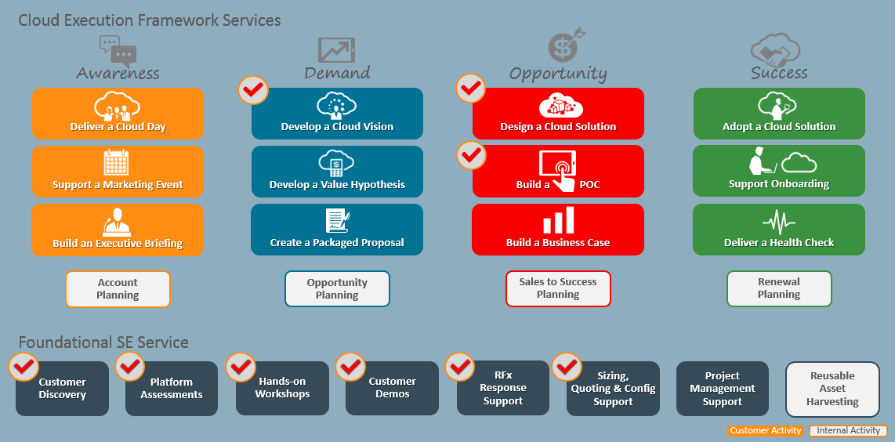

NATD Solution Engineering Service Catalog
How do Field SEs collaborate with Hub SEs?
What SEaaS Services do hub SEs support?
Pilot SE Service where Platform Specialists and/or Hub SEs are engaged.

Slide 4
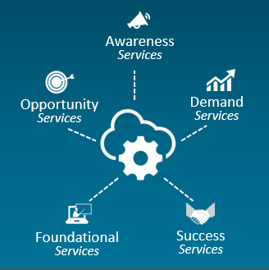













Hub SE Engagement in SEaaS Services
1
3
Request for SE Resources
SCRM System
Request a Service from the SEaaS Catalog
Sales Rep
CPR | ECA
Specialist Rep
Analytics Rep
HW Rep
2
Create Engagement
Note: In Q1, this occurs outside of SCRM. In second Half of FY18, Services will be available for selection in SCRM.
Are Platform Specialists needed?
Do Hub SEs support this service?
Note: Initially, Hub SEs are assigned along with Platform Specialists for special on-the-job training.
5
4
Yes and Yes
Assign
Platform Specialist & Hub SE Resources
Platform
Hub
Platform Specialist
Hub SE
Process is coming.
Security
Integration
AppDev
IaaS
Info Mgmt
Analytics
Eng Sys
Servers
Storage

Slide 5

Q.
Note: More info is coming soon including detailed Service Definitions. A newer version of this PPT will be posted to the
Oracle Cloud Solution Hub
Website on the “Our Services” page.
A.

